Slide 1
GEM Parking Wizard: HyperGemini
Keeron Huang, Xinchen Yao, Yixiao Liu, Xiaocheng Zhang qixuan3, yao29, yixiaol2, xz105
March 13th 2025

Slide 2

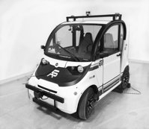
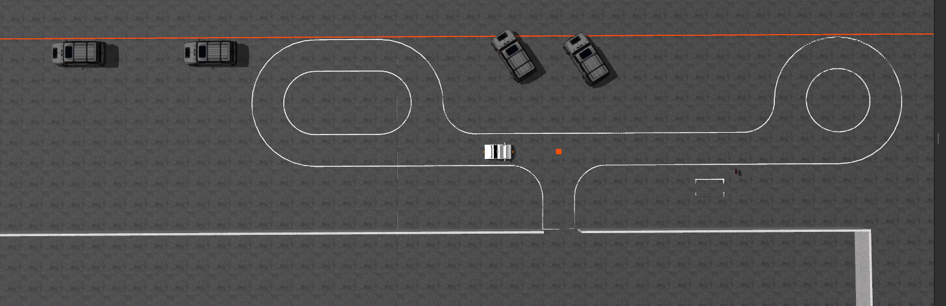
What problem are we solving?
We aim to create an autonomous driving module capable of detecting and parking in both diagonal and parallel parking spots.
Nonholonomic Control Constraints: Limited steering curvature, making accurate path planning and motion control in tight spaces challenging.
Complex Sensing and Perception: Reliably detecting lane boundaries and parking slot orientation requires sensor fusion, especially hard under various environmental conditions.
Use figures, graphs, and equations to convey ideas when possible and avoid walls of text
Is this challenging? Interesting?
Change as you see fit
Notes:
Nonholonomic Control Constraints: Cars have limited steering curvature, making accurate path planning and motion control in tight spaces challenging.
Complex Sensing and Perception: Reliably detecting lane boundaries and parking slot orientation requires robust vision or sensor fusion, especially under varying lighting and environment conditions.
Real-Time Decision-Making: Deciding when to initiate parking maneuvers, which trajectory to choose, and how to adapt if obstacles suddenly appear demands a reactive yet globally aware solution.
Multiple Parking Types: Handling both diagonal and parallel spots—each with its own geometry and constraints—adds complexity. The system must dynamically choose different path-generation logic depending on the detected spot.

Slide 3
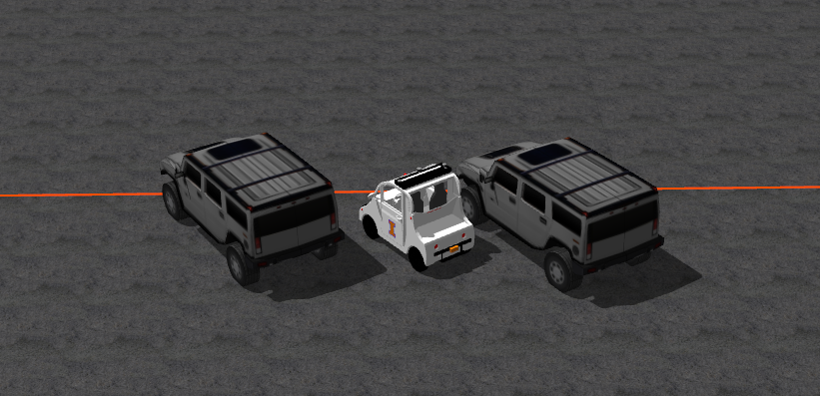
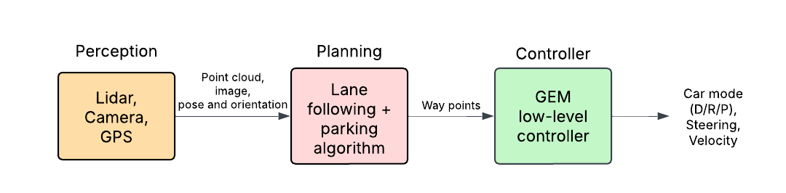
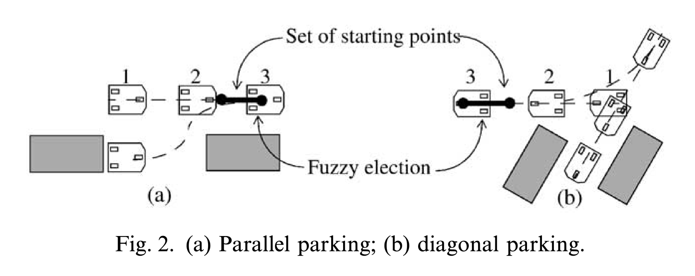
Plan and preliminary work
Give a block diagram with the major components in your system; label the input/output interfaces for the components?
Which of these components are you going to improve / create and which are already available? Give references to code/libraries you will use (ref. like this: [1])
More details here will help us give precise feedback; could span 2 slides if needed
What preliminary work have you done? Paper / code review, early simulations, etc.,?
Preliminary work:
Simulator with Highbay environment [1];
Lane following from MP1
Segmented Parking Maneuver with Real-time Collision Checking[2]
Nonholonomic Controller Tuning (PID, Pure Pursuit, Fuzzy Logic)[3]
Notes:
3. Plan, team, preliminary work
Preliminary work and progress so far: simulator working with the desired environment
Realistic milestones: 1. Good lane detection 2. Lane following 3. Diagonal parking 4. Parallel parking 5. Camera detect which parking type, then park
Task allocation in group and plan for execution of the plan:
Segmented or Iterative Planning: The parking maneuver is divided into smaller arcs or segments, with real-time checks and updates to ensure a collision-free path into the parking spot.
Sensing and Localization: They rely on sensors (ultrasonic, laser, or vision) to detect boundaries and obstacles, and use either direct pose estimation or sensor fusion (e.g., Kalman Filter) to keep track of the vehicle state.
Control Framework:
Combination of open-loop path generation (e.g., arcs, sinusoidal inputs) and closed-loop feedback (PID, Pure Pursuit, or predictive controllers) at low speeds for precise, collision-free maneuvers.
Some systems use fuzzy logic or behavior-based schemes, enabling both reactive collision avoidance and accurate nonholonomic planning.
Modifications and Novelty
Multi-arc or Smooth Paths: Rather than simple minimal-radius arcs, smooth arc-connecting segments or b-spline transitions reduce abrupt steering changes.
Local-Global Integration: Sensors handle immediate collision checks, while a short-range “planner” ensures the car can reach and fit into the desired parking slot.
Collision-free Feasibility Regions: In certain approaches, a “collision-free area” for possible starting points or arc combinations is precomputed, guiding where the car should begin its final maneuver.
Fuzzy Logic for Maneuver Selection: Among multiple feasible paths, fuzzy rules weigh factors like obstacle spacing, path curvature, and parking slot size to choose a comfortable, safe final path.
Easy Aspects
Slow-speed Scenario: At low speeds, a simpler kinematic model is valid; control primarily involves steering and speed without heavy dynamic effects.
Standard Sensors: Basic ultrasonic or laser range sensors suffice for short-range detection, typical of parking tasks.
Simple Control Tuning: PID or Pure Pursuit strategies are well-known and relatively straightforward to tune for slow maneuvers.

Slide 4
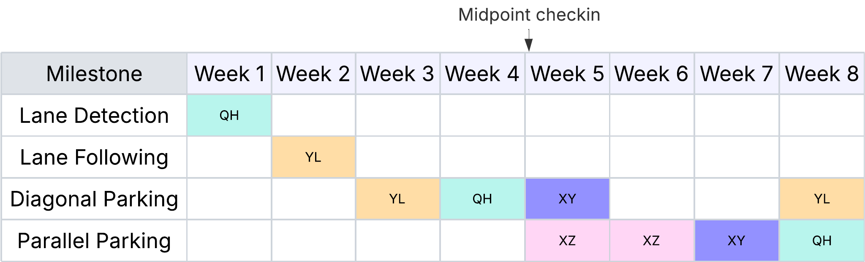
Timeline, Task allocation, and Approach
Implement lane detection and lane following using the provided code and prior mps
Identify key parking checkpoints and control strategies for both parking situations
Achieve a comprehensive automated driving and parking solution

Slide 5
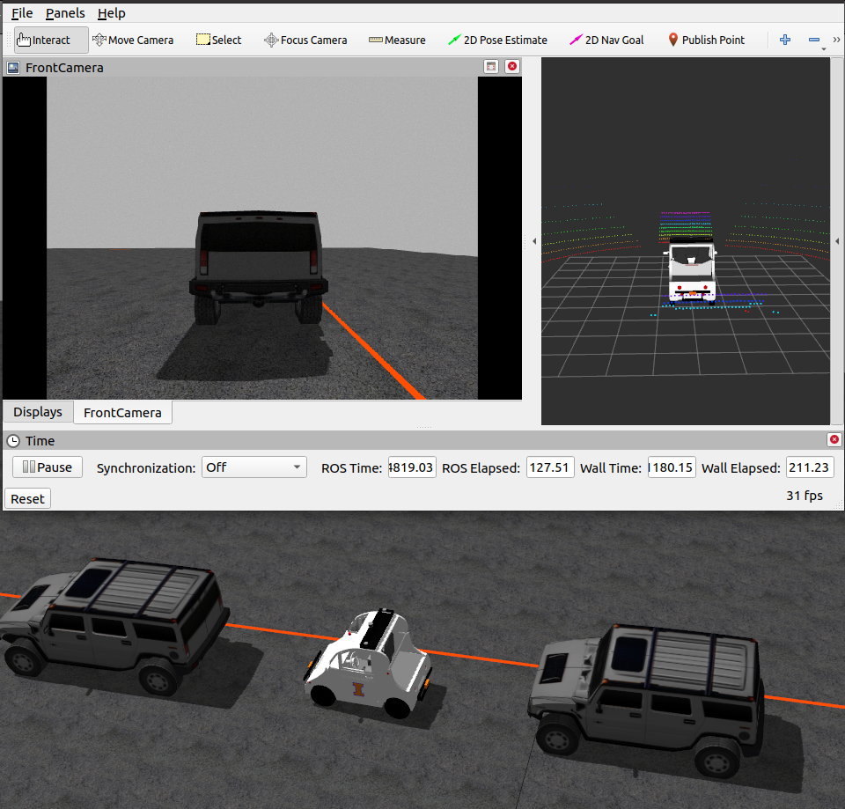
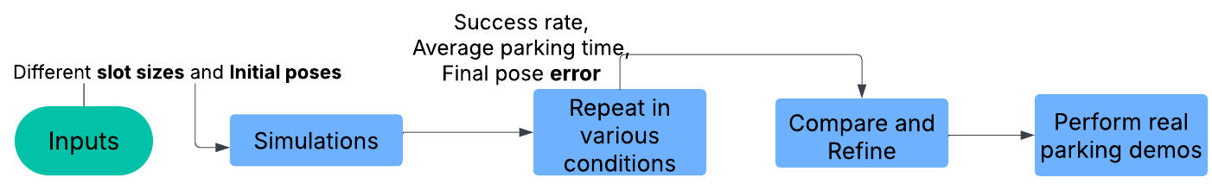
Metrics for evaluation
Accuracy Tracking Error: Checks how accurately the car follows the planned path; final pose accuracy is crucial.
Efficiency Parking Time + Steering Smoothness: Evaluates steering smoothness (affecting comfort and control stability).
Security Collision/Safety Distance: Ensures minimum clearance from obstacles at all times.
Notes:
2. Approach: How you plan to solve the problem?
Do you understand the overall system and its various components?
Which pieces are you going to modify and how?
Implement lane detection with provided code
Base on the lane detection algorithm we modified, implement lane following
Train the simple diagonal parking by recognizing checkpoints and then train the parallel parking based on that
Identify different kinds of parking spaces and park respectively
What are the aspects of the approach that are most novel? Which aspects are easy
The hardest: identify different parking spaces and choose different parking strategies accordingly
The easiest: implementing lane detection
4. Test and evaluation: What are the key metrics for evaluating the solution to your problem. E.g., time-to-collision is a metric for safety;
How are you evaluating your solution with respect to your metrics?
Are you simulating as well as performing field tests? Simulations?
What are the different scenarios under which you are performing evaluation?
How do you plan to solve the problem?
Sensing: Use LIDAR, cameras, and/or ultrasonic sensors to detect parking spaces and obstacles.
Planning: Implement a path planning algorithm (e.g., RRT*, A* or Model Predictive Control).
Control: Use trajectory tracking control (PID, pure pursuit, or LQR).
Integration: Develop a ROS-based system to coordinate perception, planning, and control.
Which components are you modifying?
Adding sensor suite for perception.
Implementing new software for parking maneuver execution.
Fine-tuning the control system for precision.
Accuracy: How close is the final parked position to the target?
Time Efficiency: How quickly does the system park?
Collision Avoidance: Does the system reliably detect and avoid obstacles?
Success Rate: Percentage of successful parking attempts.
Scalability: Performance in different parking scenarios (tight spaces, angled parking).
1. Key Evaluation Metrics
Lane Detection Accuracy
Lane Marking Detection Rate: How often the system correctly identifies lane boundaries.
Lateral Deviation: The difference between the vehicle’s centerline and the detected lane center.
Lane Following Stability
Steering Smoothness: Variation or jitter in the steering angle while following the lane.
Lane Keep Success Rate: Percentage of time the vehicle remains within lane boundaries without requiring intervention.
Parking Performance
Parking Accuracy: The final lateral and longitudinal offset from the desired parking position.
Parking Time: Time taken from the start of the parking maneuver to final position.
Success/Failure Rate: Number of successful parks versus unsuccessful attempts over multiple trials.
Safety Metrics
Time-to-Collision (TTC): How much time remains before collision if no evasive action is taken—crucial for measuring safety margins.
Minimum Distance to Obstacles: Closest approach to any static or dynamic obstacle during maneuvers.
Localization Reliability
Position Error: Difference between actual (ground truth) and estimated position from LiDAR-GPS fusion.
Heading Error: Error in the estimated heading or orientation of the vehicle.
2. Evaluation Methodologies
Simulation Testing
Software-in-the-Loop (SIL): Using a simulation environment (e.g., CARLA, Gazebo, or a custom simulator) to run the lane detection, planning, and control algorithms. This allows rapid iteration without risk to real-world assets.
Scenario Variation: Change lighting conditions, weather, road curvature, and traffic presence to stress-test the algorithms.
Hardware-in-the-Loop (HIL)
Incorporate actual vehicle sensors or sensor simulations to test real-time performance.
Validate that the controller can handle real sensor data latencies and noise characteristics.
Field Testing
Closed-Track Tests: Evaluate on a test track to measure lane-following, parking accuracy, and safety metrics in a controlled environment.
Real-World Urban/Highway Driving: Assess the robustness of perception (LiDAR, GPS, cameras) and controller performance in various traffic conditions, road types, and dynamic obstacles.
3. Evaluation Scenarios
Lane Following Scenarios
Straight Roads & Curvy Roads: Assess lane detection and steering control under mild and aggressive curvature.
Different Lighting & Weather: Morning vs. night, clear vs. rainy/foggy conditions to test perception robustness.
Parking Scenarios
Diagonal Parking: Vary the angle of the parking spot. Check how quickly and accurately the system identifies the spot and executes the diagonal parking controller.
Parallel Parking: Include spots of different lengths and partial obstructions (e.g., a vehicle slightly overhanging the parking lines).
Empty vs. Occupied Spots: Ensure the system accurately detects free spaces vs. spaces already taken.
Mixed Environment
Transition from Lane Following to Parking: Evaluate how smoothly the system switches from lane-keeping to identifying a parking space, selecting the correct algorithm (diagonal or parallel), and executing the park.
Dynamic Obstacles: Include pedestrians or other vehicles during the parking maneuver to test reactive safety protocols.
4. Linking Back to the System Components
Lane Detection and Lane Following
Leverage the provided code and prior modules (MPs) for lane detection.
Evaluate detection output against ground truth or manually annotated datasets.
Measure lateral deviation and steering response in real time.
Parking Checkpoints and Control Strategies
Identify the critical points (e.g., reference points near the parking slot) that guide the trajectory.
For both diagonal and parallel parking, track lateral/longitudinal offset, approach speed, and final positioning.
Perception System Integration (LiDAR + GPS)
Assess the accuracy of sensor fusion in different environments (urban canyon vs. open roads).
Monitor and log real-time position/heading errors compared to ground truth (e.g., RTK-GPS data).
Adaptive Parking Algorithms
Ensure the system can detect the parking space type (diagonal or parallel) and automatically select the corresponding maneuver.
Validate that transitions between lane following and parking maneuvers are seamless and safe.
5. Comprehensive Automated Driving & Parking Solution
By combining:
Lane Detection and Lane Following
Parking Spot Classification and Control Strategies
Integrated Perception (LiDAR + GPS) the system should demonstrate:
High lane-keeping accuracy under varied scenarios.
Robust parking maneuver execution for diagonal and parallel spaces.
Safe operation measured by time-to-collision, minimum obstacle distance, and minimal or zero collisions.
Adaptability to different environments, lighting conditions, and partial occlusions.

Slide 6
Reference
Give a block diagram with the major components in your system; label the input/output interfaces for the components?
Which of these components are you going to improve / create and which are already available? Give references to code/libraries you will use (ref. like this: [1])
More details here will help us give precise feedback; could span 2 slides if needed
What preliminary work have you done? Paper / code review, early simulations, etc.,?
[1] https://github.com/hangcui1201/POLARIS_GEM_e2_Simulator
[2] Gómez-Bravo et al. (2001) F. Gómez-Bravo, F. Cuesta, A. Ollero, "Parallel and diagonal parking in nonholonomic autonomous vehicles," Engineering Applications of Artificial Intelligence, Vol. 14, Issue 4, 2001, pp. 419–434, ISSN 0952-1976, https://doi.org/10.1016/S0952-1976(01)00004-5.
[3] Paromtchik & Laugier (1996) I. E. Paromtchik and C. Laugier, "Autonomous parallel parking of a nonholonomic vehicle," Proceedings of Conference on Intelligent Vehicles, Tokyo, Japan, 1996, pp. 13–18, doi: 10.1109/IVS.1996.566343.
Notes:
3. Plan, team, preliminary work
Preliminary work and progress so far: simulator working with the desired environment
Realistic milestones: 1. Good lane detection 2. Lane following 3. Diagonal parking 4. Parallel parking 5. Camera detect which parking type, then park
Task allocation in group and plan for execution of the plan:
Segmented or Iterative Planning: The parking maneuver is divided into smaller arcs or segments, with real-time checks and updates to ensure a collision-free path into the parking spot.
Sensing and Localization: They rely on sensors (ultrasonic, laser, or vision) to detect boundaries and obstacles, and use either direct pose estimation or sensor fusion (e.g., Kalman Filter) to keep track of the vehicle state.
Control Framework:
Combination of open-loop path generation (e.g., arcs, sinusoidal inputs) and closed-loop feedback (PID, Pure Pursuit, or predictive controllers) at low speeds for precise, collision-free maneuvers.
Some systems use fuzzy logic or behavior-based schemes, enabling both reactive collision avoidance and accurate nonholonomic planning.
Modifications and Novelty
Multi-arc or Smooth Paths: Rather than simple minimal-radius arcs, smooth arc-connecting segments or b-spline transitions reduce abrupt steering changes.
Local-Global Integration: Sensors handle immediate collision checks, while a short-range “planner” ensures the car can reach and fit into the desired parking slot.
Collision-free Feasibility Regions: In certain approaches, a “collision-free area” for possible starting points or arc combinations is precomputed, guiding where the car should begin its final maneuver.
Fuzzy Logic for Maneuver Selection: Among multiple feasible paths, fuzzy rules weigh factors like obstacle spacing, path curvature, and parking slot size to choose a comfortable, safe final path.
Easy Aspects
Slow-speed Scenario: At low speeds, a simpler kinematic model is valid; control primarily involves steering and speed without heavy dynamic effects.
Standard Sensors: Basic ultrasonic or laser range sensors suffice for short-range detection, typical of parking tasks.
Simple Control Tuning: PID or Pure Pursuit strategies are well-known and relatively straightforward to tune for slow maneuvers.

Slide 7
Preliminary work
Give a block diagram with the major components in your system; label the input/output interfaces for the components?
Which of these components are you going to improve / create and which are already available? Give references to code/libraries you will use (ref. like this: [1])
More details here will help us give precise feedback; could span 2 slides if needed
What preliminary work have you done? Paper / code review, early simulations, etc.,?
Segmented or Iterative Planning:
Lidar detection
Nonholonomic Controller Tuning
We will refine the controller parameters (e.g. PID or Pure Pursuit gains) for better tracking in tight spaces. (fuzzy logic)
[2]
Notes:
3. Plan, team, preliminary work
Preliminary work and progress so far: simulator working with the desired environment
Realistic milestones: 1. Good lane detection 2. Lane following 3. Diagonal parking 4. Parallel parking 5. Camera detect which parking type, then park
Task allocation in group and plan for execution of the plan:
Segmented or Iterative Planning: The parking maneuver is divided into smaller arcs or segments, with real-time checks and updates to ensure a collision-free path into the parking spot.
Sensing and Localization: They rely on sensors (ultrasonic, laser, or vision) to detect boundaries and obstacles, and use either direct pose estimation or sensor fusion (e.g., Kalman Filter) to keep track of the vehicle state.
Control Framework:
Combination of open-loop path generation (e.g., arcs, sinusoidal inputs) and closed-loop feedback (PID, Pure Pursuit, or predictive controllers) at low speeds for precise, collision-free maneuvers.
Some systems use fuzzy logic or behavior-based schemes, enabling both reactive collision avoidance and accurate nonholonomic planning.
Modifications and Novelty
Multi-arc or Smooth Paths: Rather than simple minimal-radius arcs, smooth arc-connecting segments or b-spline transitions reduce abrupt steering changes.
Local-Global Integration: Sensors handle immediate collision checks, while a short-range “planner” ensures the car can reach and fit into the desired parking slot.
Collision-free Feasibility Regions: In certain approaches, a “collision-free area” for possible starting points or arc combinations is precomputed, guiding where the car should begin its final maneuver.
Fuzzy Logic for Maneuver Selection: Among multiple feasible paths, fuzzy rules weigh factors like obstacle spacing, path curvature, and parking slot size to choose a comfortable, safe final path.
Easy Aspects
Slow-speed Scenario: At low speeds, a simpler kinematic model is valid; control primarily involves steering and speed without heavy dynamic effects.
Standard Sensors: Basic ultrasonic or laser range sensors suffice for short-range detection, typical of parking tasks.
Simple Control Tuning: PID or Pure Pursuit strategies are well-known and relatively straightforward to tune for slow maneuvers.

Slide 8
Task allocation
Qixuan Huang
Parameter tuning and debugging.
Validate system stability and optimize performance.
Xiaocheng Zhang
Implement and optimize lane detection.
Develop a robust parking slot detection and classification mechanism.
Xinchen Yao
Design parking control algorithms for both parking.
Integrate trajectory planning with vehicle motion control.
Yixiao Liu
Set up simulation environments for system testing.
Create varied scenarios for overall integration.

Slide 9
Approach
Notes:
Implement lane detection using the provided code and prior mps, and utilize the detection output as the basis for a robust lane-following algorithm.
Identify key parking checkpoints and control strategies for both diagonal and parallel parking maneuvers, encompassing trajectory planning and vehicle motion control.
Integrate these controllers with the vehicle’s perception system, with LiDAR and GPS data for accurate localization and environmental understanding,
achieve a comprehensive automated driving and parking solution by identifying different parking conditions, navigating to them using lane following, and utilizing different algorithms respectively.

Slide 10
Evaluation Procedure
Step 1: Conduct simulations, using validate path-planning performance under different slot sizes and initial poses.
Step 2: Repeat in various conditions (slot widths, vehicle & slot orientations) to obtain success rate, average parking time, final pose error.
Step 3: Compare and refine models, highlighting discrepancies between simulations tests.
Step 4: Perform real parking demos in highbay, tracking data for each run.
Notes:
2. Approach: How you plan to solve the problem?
Do you understand the overall system and its various components?
Which pieces are you going to modify and how?
Implement lane detection with provided code
Base on the lane detection algorithm we modified, implement lane following
Train the simple diagonal parking by recognizing checkpoints and then train the parallel parking based on that
Identify different kinds of parking spaces and park respectively
What are the aspects of the approach that are most novel? Which aspects are easy
The hardest: identify different parking spaces and choose different parking strategies accordingly
The easiest: implementing lane detection
4. Test and evaluation: What are the key metrics for evaluating the solution to your problem. E.g., time-to-collision is a metric for safety;
How are you evaluating your solution with respect to your metrics?
Are you simulating as well as performing field tests? Simulations?
What are the different scenarios under which you are performing evaluation?
How do you plan to solve the problem?
Sensing: Use LIDAR, cameras, and/or ultrasonic sensors to detect parking spaces and obstacles.
Planning: Implement a path planning algorithm (e.g., RRT*, A* or Model Predictive Control).
Control: Use trajectory tracking control (PID, pure pursuit, or LQR).
Integration: Develop a ROS-based system to coordinate perception, planning, and control.
Which components are you modifying?
Adding sensor suite for perception.
Implementing new software for parking maneuver execution.
Fine-tuning the control system for precision.
Accuracy: How close is the final parked position to the target?
Time Efficiency: How quickly does the system park?
Collision Avoidance: Does the system reliably detect and avoid obstacles?
Success Rate: Percentage of successful parking attempts.
Scalability: Performance in different parking scenarios (tight spaces, angled parking).
1. Key Evaluation Metrics
Lane Detection Accuracy
Lane Marking Detection Rate: How often the system correctly identifies lane boundaries.
Lateral Deviation: The difference between the vehicle’s centerline and the detected lane center.
Lane Following Stability
Steering Smoothness: Variation or jitter in the steering angle while following the lane.
Lane Keep Success Rate: Percentage of time the vehicle remains within lane boundaries without requiring intervention.
Parking Performance
Parking Accuracy: The final lateral and longitudinal offset from the desired parking position.
Parking Time: Time taken from the start of the parking maneuver to final position.
Success/Failure Rate: Number of successful parks versus unsuccessful attempts over multiple trials.
Safety Metrics
Time-to-Collision (TTC): How much time remains before collision if no evasive action is taken—crucial for measuring safety margins.
Minimum Distance to Obstacles: Closest approach to any static or dynamic obstacle during maneuvers.
Localization Reliability
Position Error: Difference between actual (ground truth) and estimated position from LiDAR-GPS fusion.
Heading Error: Error in the estimated heading or orientation of the vehicle.
2. Evaluation Methodologies
Simulation Testing
Software-in-the-Loop (SIL): Using a simulation environment (e.g., CARLA, Gazebo, or a custom simulator) to run the lane detection, planning, and control algorithms. This allows rapid iteration without risk to real-world assets.
Scenario Variation: Change lighting conditions, weather, road curvature, and traffic presence to stress-test the algorithms.
Hardware-in-the-Loop (HIL)
Incorporate actual vehicle sensors or sensor simulations to test real-time performance.
Validate that the controller can handle real sensor data latencies and noise characteristics.
Field Testing
Closed-Track Tests: Evaluate on a test track to measure lane-following, parking accuracy, and safety metrics in a controlled environment.
Real-World Urban/Highway Driving: Assess the robustness of perception (LiDAR, GPS, cameras) and controller performance in various traffic conditions, road types, and dynamic obstacles.
3. Evaluation Scenarios
Lane Following Scenarios
Straight Roads & Curvy Roads: Assess lane detection and steering control under mild and aggressive curvature.
Different Lighting & Weather: Morning vs. night, clear vs. rainy/foggy conditions to test perception robustness.
Parking Scenarios
Diagonal Parking: Vary the angle of the parking spot. Check how quickly and accurately the system identifies the spot and executes the diagonal parking controller.
Parallel Parking: Include spots of different lengths and partial obstructions (e.g., a vehicle slightly overhanging the parking lines).
Empty vs. Occupied Spots: Ensure the system accurately detects free spaces vs. spaces already taken.
Mixed Environment
Transition from Lane Following to Parking: Evaluate how smoothly the system switches from lane-keeping to identifying a parking space, selecting the correct algorithm (diagonal or parallel), and executing the park.
Dynamic Obstacles: Include pedestrians or other vehicles during the parking maneuver to test reactive safety protocols.
4. Linking Back to the System Components
Lane Detection and Lane Following
Leverage the provided code and prior modules (MPs) for lane detection.
Evaluate detection output against ground truth or manually annotated datasets.
Measure lateral deviation and steering response in real time.
Parking Checkpoints and Control Strategies
Identify the critical points (e.g., reference points near the parking slot) that guide the trajectory.
For both diagonal and parallel parking, track lateral/longitudinal offset, approach speed, and final positioning.
Perception System Integration (LiDAR + GPS)
Assess the accuracy of sensor fusion in different environments (urban canyon vs. open roads).
Monitor and log real-time position/heading errors compared to ground truth (e.g., RTK-GPS data).
Adaptive Parking Algorithms
Ensure the system can detect the parking space type (diagonal or parallel) and automatically select the corresponding maneuver.
Validate that transitions between lane following and parking maneuvers are seamless and safe.
5. Comprehensive Automated Driving & Parking Solution
By combining:
Lane Detection and Lane Following
Parking Spot Classification and Control Strategies
Integrated Perception (LiDAR + GPS) the system should demonstrate:
High lane-keeping accuracy under varied scenarios.
Robust parking maneuver execution for diagonal and parallel spaces.
Safe operation measured by time-to-collision, minimum obstacle distance, and minimal or zero collisions.
Adaptability to different environments, lighting conditions, and partial occlusions.

Slide 11
Grading Plan
The project is an opportunity to learn and discover principles of safe autonomy, while building something cool. The following slides give you templates for 4 different types of projects. The templates lay out the first rungs, not the summit. Here are the aspects we will pay attention to as we evaluate your pitch presentation and later the project.
Each category is equally weighted on the rubric:
Problem definition: What problem are you solving? Why is it hard and interesting?
Is the problem formulation detailed enough?
Does the problem formulation show adequate understanding of the problem space?
Appropriately ambitious?
Approach: How you plan to solve the problem?
Do you understand the overall system and its various components?
Which pieces are you going to modify and how?
What are the aspects of the approach that are most novel? Which aspects are easy
Plan, team, preliminary work
Preliminary work and progress so far
Realistic milestones
Task allocation in group and plan for execution of the plan
Test and evaluation: What are the key metrics for evaluating the solution to your problem. E.g., time-to-collision is a metric for safety;
How are you evaluating your solution with respect to your metrics?
Are you simulating as well as performing field tests? Simulations?
What are the different scenarios under which you are performing evaluation?
Presentation
Design and organization of information
Professionalism of presentation, delivery
Notes:
https://docs.google.com/presentation/d/1PbTxtX8nvptPyD0umNk0_iH_JjaDuu00pM_syHpETmQ/edit?usp=sharing

Slide 12
